Slide 1
Agile- Overview
April 2017

Slide 2


Module Objectives
Note to the SME : Please provide the module Objectives or validate the partially updated content
What you will learn
At the end of this module, you will learn:
The Overview of Agile and Scrum
What you will be able to do
At the end of this module, you be able to:
Understand the need for Agile
Describe the differences between Waterfall and Agile
State the Agile Manifesto
List the Agile Principles

Slide 3
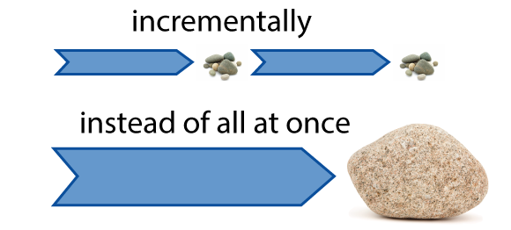
What is Agile
Agile is a time boxed, iterative approach to software delivery that builds software incrementally from the start of the project, instead of trying to deliver it all at once near the end.

Slide 4
Contd.,
Agile emphasizes iterative and incremental development, close collaboration with the customer, and cross-functional teams to build working software.
Philosophy: People, Collaboration and Values

Slide 5
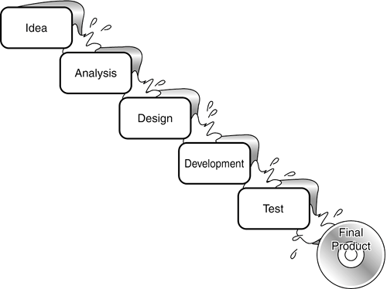
Waterfall Challenges
Customer satisfaction
Change is everywhere
Timeframe to
deliver a value
Feedback time
Understanding of a team
World doesn’t sleep

Slide 6
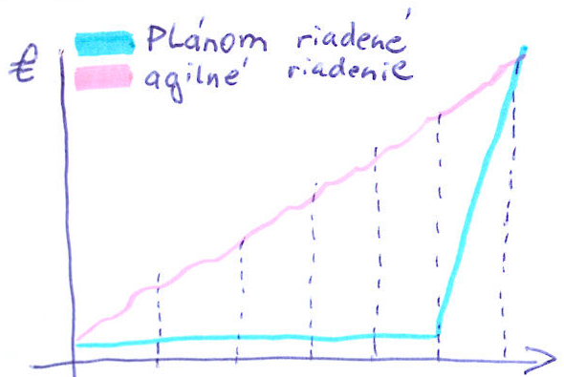
Check & Deliver
A value in Agile is delivered during the development, not just at the end
Waterfall
Agile

Slide 7
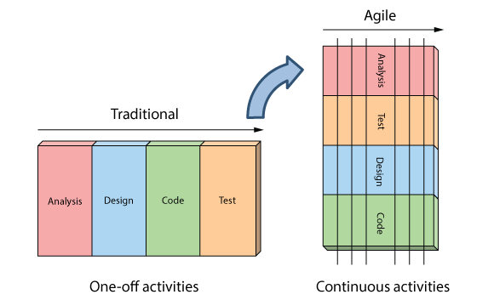
How is Agile Different ?
Analysis, design, coding, and testing are continuous activities

Slide 8
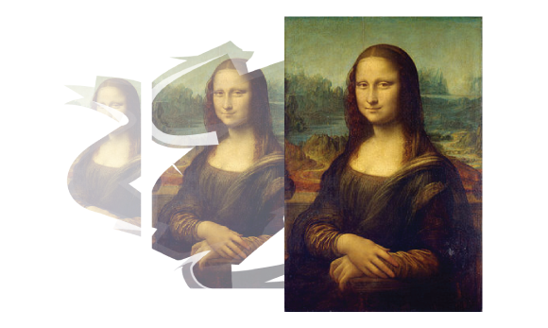
Contd.,
Development is iterative
Iterative development means starting with something really simple, and adding to it incrementally over time.

Slide 9
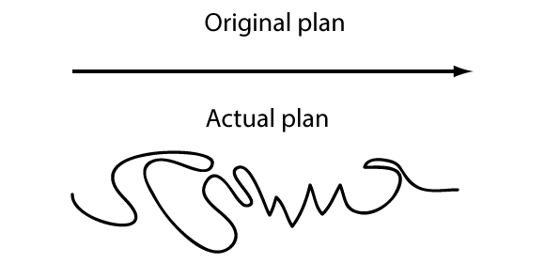
Contd.,
Planning Is adaptive
When reality disagrees with their plans, Agilists find it easier to change their plans than reality. They call this adaptive planning.

Slide 10
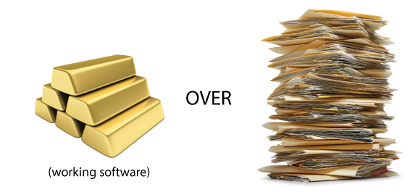
What is the Primary Measure of Success ?
Working software is the primary measure of success

Slide 11
Manifesto for Agile
Individuals and Interactions
Processes and Tools
over
Working Software
Comprehensive documentation
over
Customer Collaboration
contract negotiation
over
Responding to change
following a plan
over
While there is value in the items on the right, We value the items on the left more.

Slide 12
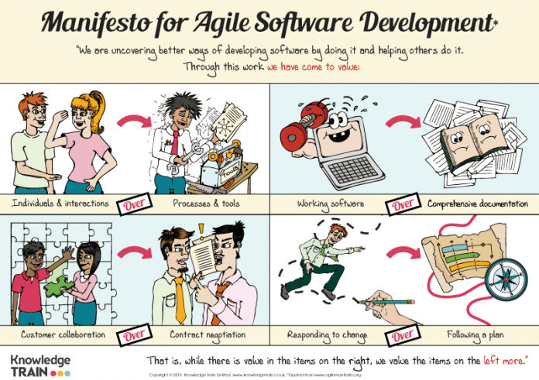
Agile Manifesto

Slide 13
Value 1: Individuals and Interactions over Processes and Tools
Strong players: a must, but can fail if don’t work together.
Strong player: not necessarily an ‘ace;’ work well with others!
Communication and interacting is more important than raw talent.
‘Right’ tools are vital to smooth functioning of a team.

Slide 14
Value 1: Individuals and Interactions over Processes and Tools
Start small. Find a free tool and use until you can demo you’ve outgrown it. Don’t assume bigger is better. Start with white board; flat files before going to a huge database.
Building a team more important than building environment.
Some managers build the environment and expect the team to fall together.
Doesn’t work.
Let the team build the environment on the basis of need.

Slide 15
Value 2: Working Software over Comprehensive Documentation
Examples
Samsung.
RedBus
How to train newbees if short & sweet?
Work closely with them.
Transfer knowledge by sitting with them; make part of team via close training and interaction

Slide 16
Value 3: Customer Collaboration over Contract Negotiation (1 of 2)
Not possible to describe software requirements up front and leave someone else to develop it within cost and on time.
Customers cannot just cite needs and go away
Successful projects require customer feedback on a regular and frequent basis – and not dependent upon a contract .

Slide 17
Value 3: Customer Collaboration over Contract Negotiation (2 of 2)
Best contracts are NOT those specifying requirements, schedule and cost.
Become meaningless shortly.
Far better are contracts that govern the way the development team and customer will work together.
Key is intense collaboration with customer and a contract that governed collaboration rather than details of scope and schedule
Details ideally not specified in contract.
Rather contracts could pay when a block passed customer’s acceptance tests.
With frequent deliverables and feedback, acceptance tests never an issue.

Slide 18
Value 4: Responding to Change over Following a Plan
Our plans and the ability to respond to changes is critical!
Better planning strategy – make detailed plans for the next few weeks, very rough plans for the next few months, and extremely crude plans beyond that.
Only invest in a detailed plan for immediate tasks; once plan is made, difficult to change due to momentum and commitment.
But rest of plan remains flexible. The lower resolution parts of the plan can be changed with relative ease.

Slide 19
Agile Principles
Our highest priority is to satisfy customer through early and continuous delivery of valuable software
Welcome changing requirements, even in late development.
Working software is delivered frequently (weeks rather than months)
Close, daily cooperation between business people and developers
Projects are built around motivated individuals, give them environment and support their needs, and trust them to get the job done.
Face-to-face conversation is the best form of communication (co-location)

Slide 20
Agile Principles
7. Working software is the principal measure of progress
8. Sustainable development, able to maintain a constant pace
9. Continuous attention to technical excellence and good design
10. Simplicity—the art of maximizing the amount of work not done—is essential
11 Best architectures, requirements, and designs emerge from self-organizing teams
12. Regularly, the team reflects on how to become more effective, and adjusts accordingly

Slide 21
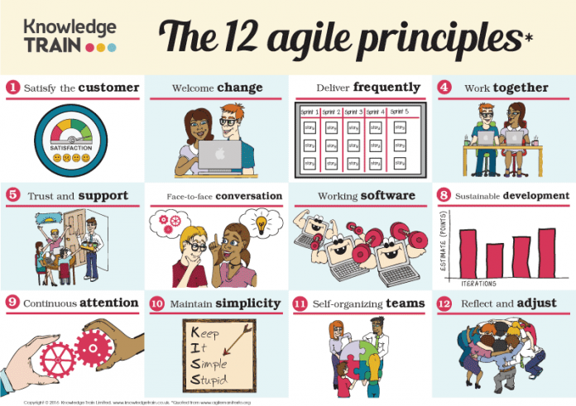
Agile – 12 Principles

Slide 22
Agile Process – Characteristics
Incremental and Iterative delivery:
To test assumptions and fail faster
Frequent Customer Feedback
To improve the quality of product
Flow and Emergent design
To improve quality of product and ability of the team to respond to changes

Slide 23
Agile Process – Characteristics
4. Evolving Process
To improve quality of Product and People
5. Continuous planning
To improve predictability
6. Autonomous Team
To improve self-organization
7. Cross-functional Team
To improve collaboration

Slide 24
Why do companies adapt Agile?
Accelerate Time to Market
Manage Changing Priorities
Increase Productivity
Better Align IT/Business
Enhance Software Quality
Improve Project Visibility

